Slide 1
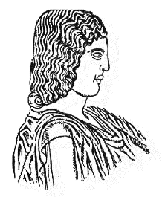
Detection of SNPs in the ITS region enables differentiation between B. dothidea and Neofusicoccum spp.
Agricultural University of Athens
Stavros Palavouzis, Alexandra Triantafyllopoulou, Aliki Tzima, and Epameinondas Paplomatas*
*Corresponding author: epaplom@aua.gr
Laboratory of Plant Pathology, Department of Crop Science, School of Plant Sciences, Agricultural University of Athens, Greece
Acknowledgements
This Research Project is co-financed by Greece and the European Union (European Social Fund) through the Operational Program «Human Resources Development, Education and Lifelong Learning 2014-2020» and the Program encoded EDBM103, titled “Support for researchers with an emphasis on young researchers-cycle B '”, in the context of the project “Risk evaluation of development of a resistant form of disease via transfer of mating type genes from the Botryosphaeria dothidea species to species of the genus Neofusicoccum” (MIS 5048471).

Slide 2
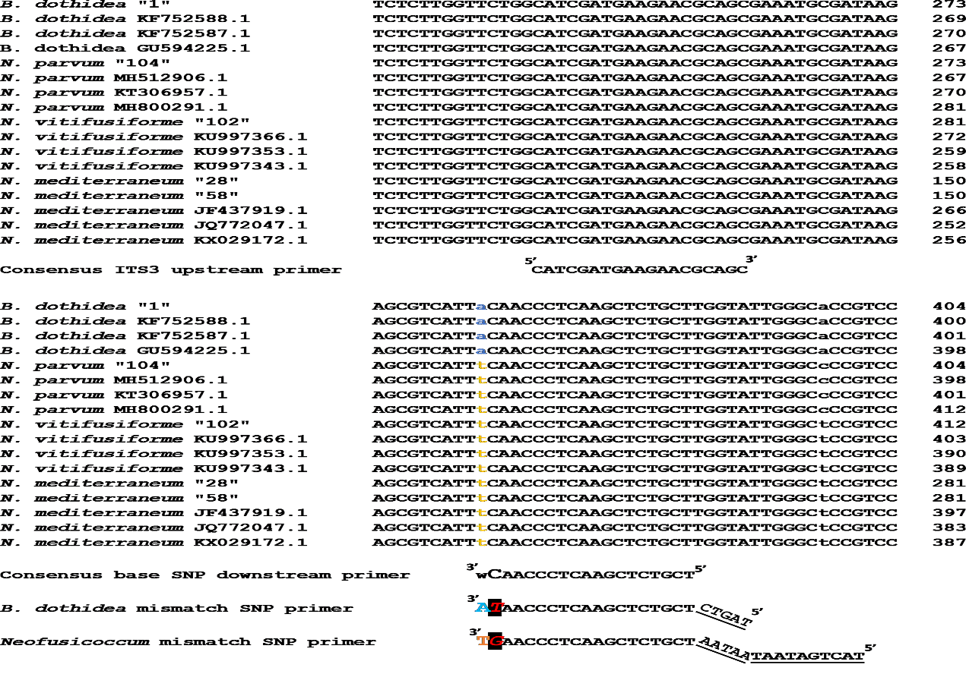
Detection of SNPs in the ITS region enables differentiation between Botryosphaeria dothidea and Neofusicoccum spp.
Stavros Palavouzis¹, Alexandra Triantafyllopoulou¹, Aliki Tzima¹, and Epameinondas Paplomatas^{1*} ¹Laboratory of Plant Pathology, Department of Crop Science, School of Plant Sciences, Agricultural University of Athens, Greece.
*Corresponding author: epaplom@aua.gr
Introduction
Botryosphaeriaceae is a family of economically important phytopathogens, with worldwide distribution
Members of the family infect a wide range of woody plants, amongst them pistachio, an important host for Greece
The most widespread species of Botryosphaeriaceae on pistachio are Botryosphaeria dothidea, Neofusicoccum vitifusiforme, N. mediterraneum and N. parvum
Problem description – objective
Rapid and cost effective differentiation between B. dothidea and Neofusicoccum spp. is of utmost importance
SNP primers on the ITS region were chosen as a rapid tool compared to other methods to discriminate between those species
ITS3 upstream primer was used with the SNP mismatch primers
As negative controls, the species Colletotrichum acutatum and Verticillium dahliae were chosen
Figure 2: 2.5% agarose gel of amplicons from SNP & mismatch primers on ITS region Left: ITS3/TL-MS-BotdoITS_386R primers Right: ITS3/TL-MS-NeofusITS_386R primers. N.p: Neofusicoccum parvum N.m.: N. mediterraneum B.d. : Botryosphaeria dothidea N.v.: N. vitifusiforme D.s.: Diplodia seriata C.a: Colletotrichum acutatum V.d.: Verticillium dahliae 64 C annealing temperature
Methodology
Sequences were aligned with CLUSTAL OMEGA and SNP areas were chosen (Figure 1)
ITS3 or ITS5 was chosen as one of the upstream primers
Initially downstream primers were designed on a 3’ SNP base only and paired with ITS5
However the PCR results were either not reproducible or inconsistent
Thus, new SNP primers were designed including a mismatch base, different for each primer, next to the 3’ end and different length tail on the 5’ end [5 bp for B. dothidea and 15 bp for Neofusicoccum spp (Gaudet et al., 2009)
Figure 1: B. dothidea , Neofusicoccum spp. alignment. SNP with mismatch primer design [mismatch base is A for B. dothidea and C for Neofusicoccum spp.
Conclusions
Assays from studies so far are elaborate, requiring additional enzymatic reactions (Gut, 2001, Gupta et al., 2001, Flowers et al., 2003, Ridgway et al., 2011).
In this study, a new rapid and cost effective molecular marker was developed
This marker can differentiate important pathogens within the Botryosphaeriaceae family
SNP mismatch allows specificity of primers designed in the conserved ITS region (high sensitivity due to high copy numbers in genome)
References:Gaudet et al, 2009. Methods Mol Biol 2009;578:415-24 Kovač et al, 2021 For. 2021, 12
Results
Primers with only 3’ SNP base did not separate efficiently the two genera Botryosphaeria and Neofusicoccum.
Only SNP primers with mismatch TL-MS-BotdoITS_386R for B. dothidea and TL-MS-NeofusITS_386R for Neofusicoccum spp. were successful in differentiating the species (Figure 2)
Diplodia seriata was also amplified with the B. dothidea SNP primer due to sequence homology at this region of ITS.
Acknowledgements
This Research Project is co-financed by Greece and the European Union (European Social Fund) through the Operational Program «Human Resources Development, Education and Lifelong Learning 2014-2020» and the Program encoded EDBM103, titled “Support for researchers with an emphasis on young researchers-cycle B '”, in the context of the project “Risk evaluation of development of a resistant form of disease via transfer of mating type genes from the Botryosphaeria dothidea species to species of the genus Neofusicoccum” (MIS 5048471).

