Slide 1
G. Bithymitris – P. Koustenis – Ch. Tselios
Class Under Siege: Studying the Spatial Dimensions of the Working-Class Vote in Piraeus and Western Attica.
11th International Conference of the Hellenic Geographical Society,
Lavrion, 12-15 April 2018
Acknowledgements: This is part of the final Deliverable of G. Bithymitris’s post-doctoral research titled “Working-class Identity Under Negotiation: The Case of West Piraeus”. The research has received a grant from the State Scholarship Foundation (IKY) as part of the Action ‘‘Support for Postdoctoral Researchers’’, OP ‘‘Development of human resources, education and lifelong learning’’ with priority axes 6, 8, 9, co-funded by the European Social Fund - ESF and the Greek State.

Slide 2
Research question:
Workers in Ship Repair Zone Vs Residents:
Similarities on social profile?
Similarities/correlations
on political attitude & electoral behavior?

Slide 3
Sample Identity
3.277 respondents
workers mostly in Ship Repair Zone
participants in 2 successive Vocational Training Programmes 2013-2015

Slide 4
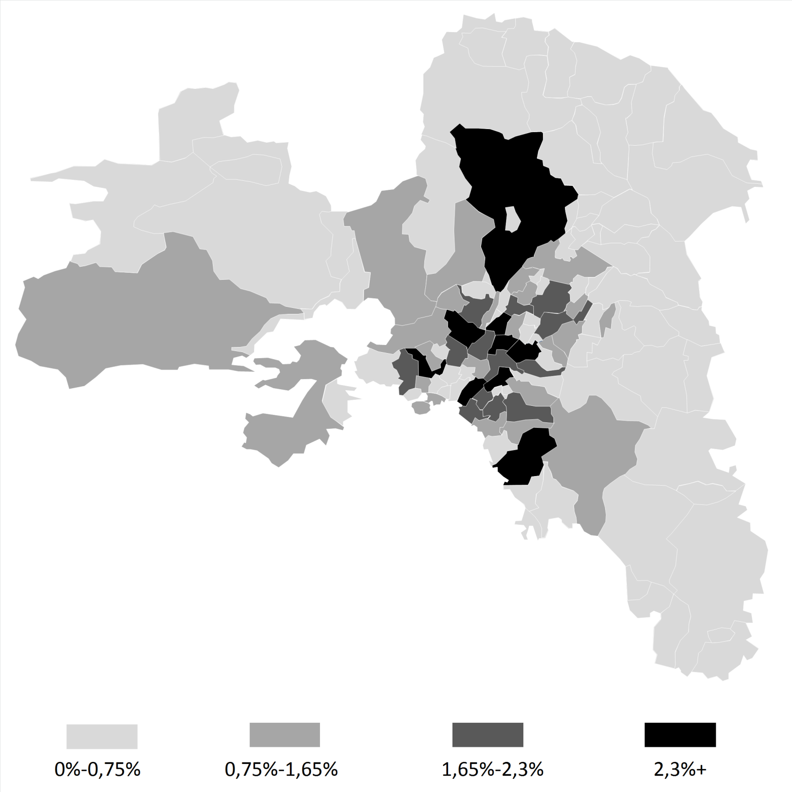
2011 Population Distribution % in Attica

Slide 5
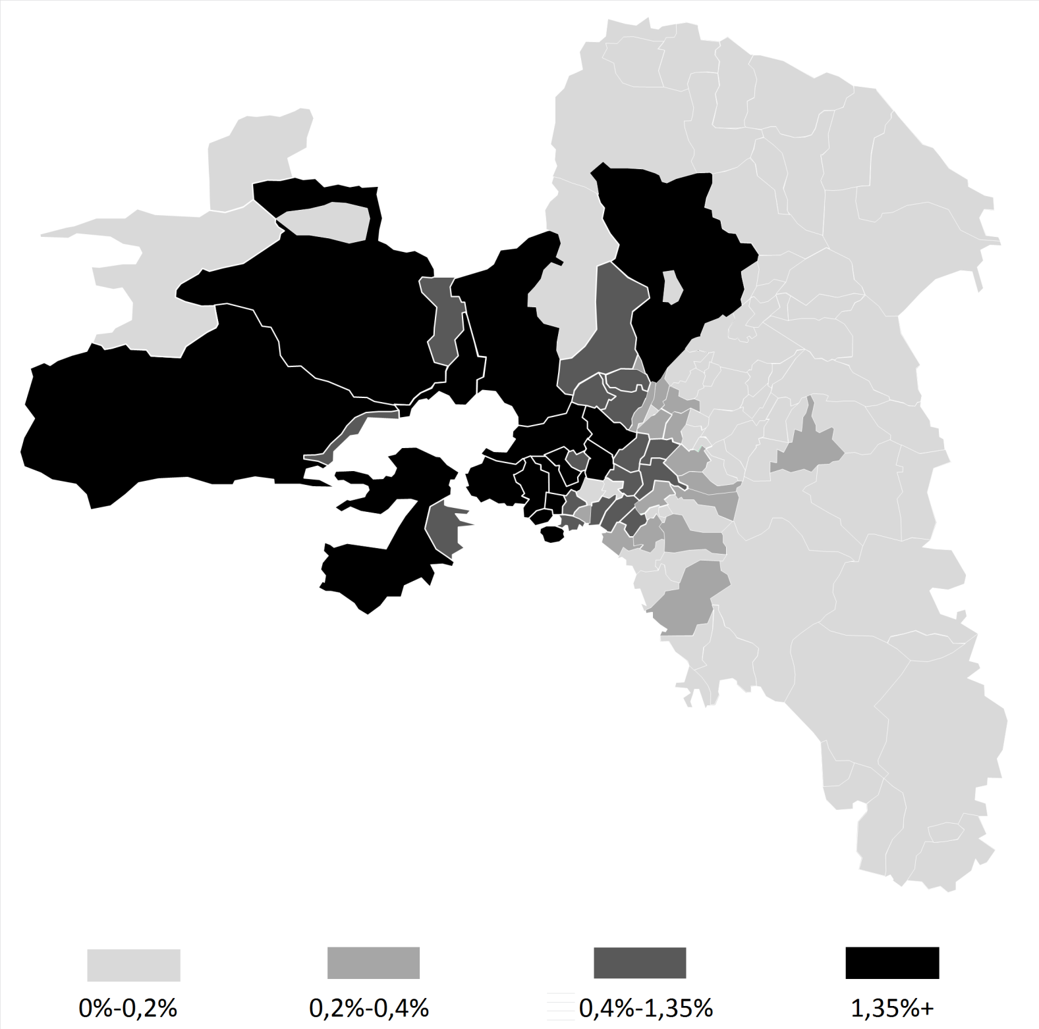
Sample Distribution %

Slide 6
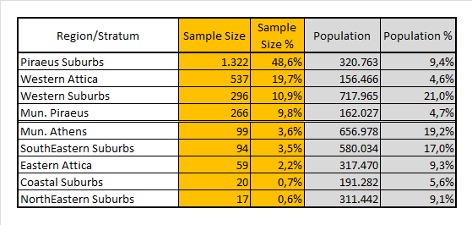
Sample Vs Population

Slide 7
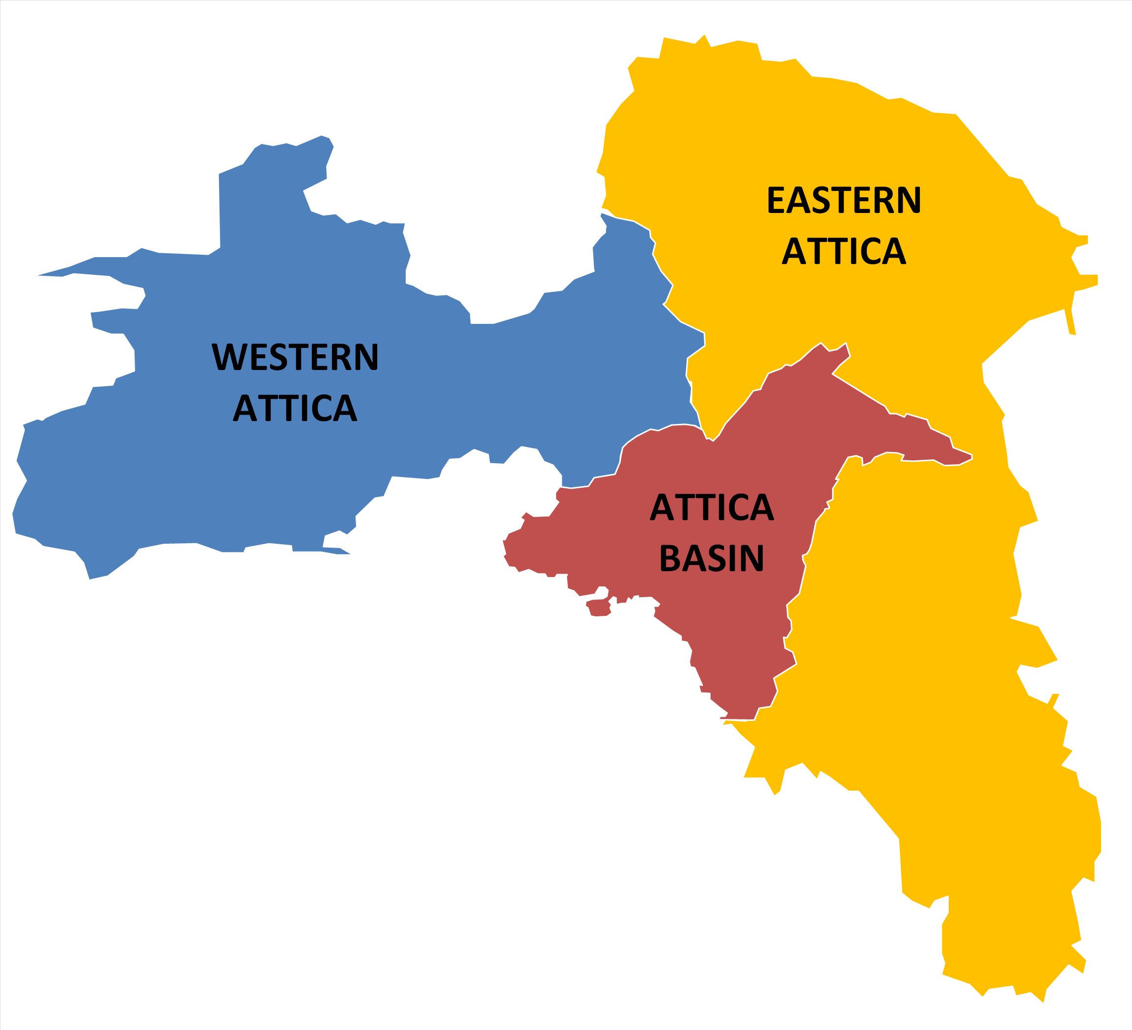
Geographical Segmentation of Attica

Slide 8
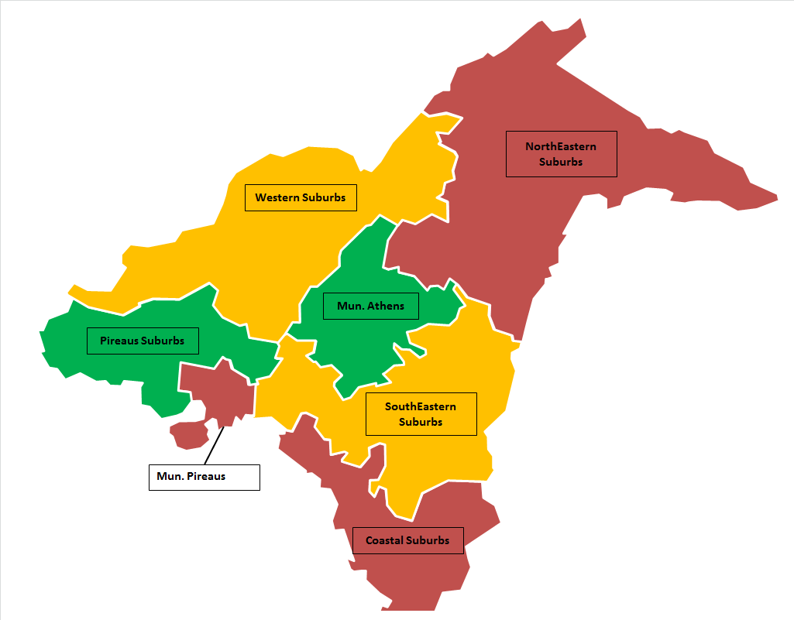
Regional Stratification of Attica Basin

Slide 9
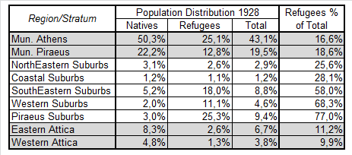
Refugees’ Installation in Attica 1928

Slide 10
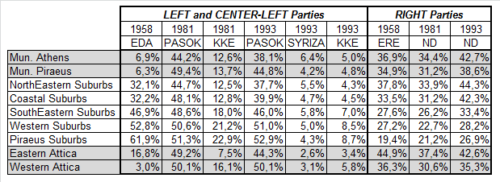
Electoral Geography Sort in Attica until 2009

Slide 11
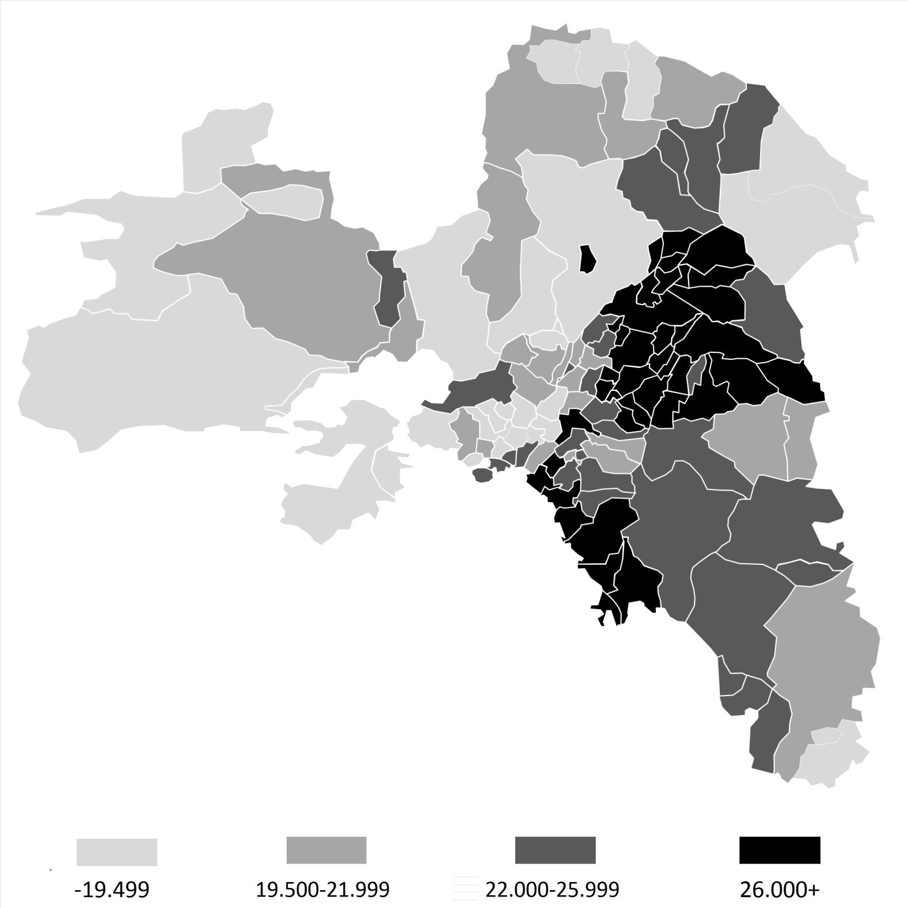
2011
Avg. Fiscal Income
(in Euros)

Slide 12
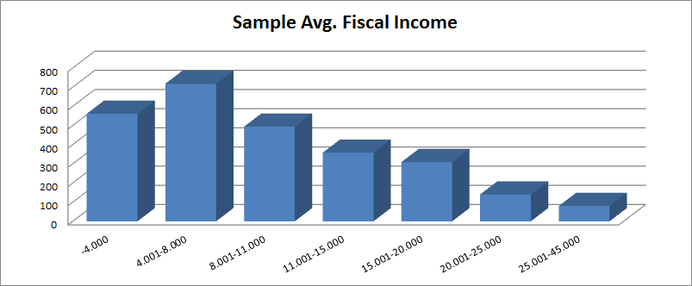

Slide 13
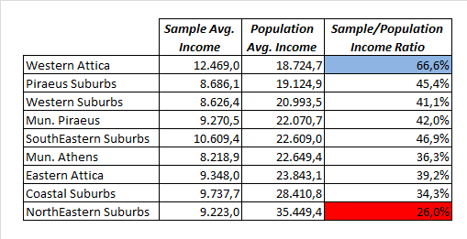
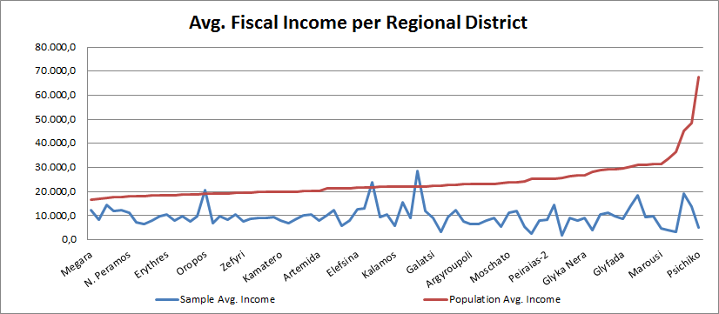
Sample Vs Population Fiscal Income

Slide 14
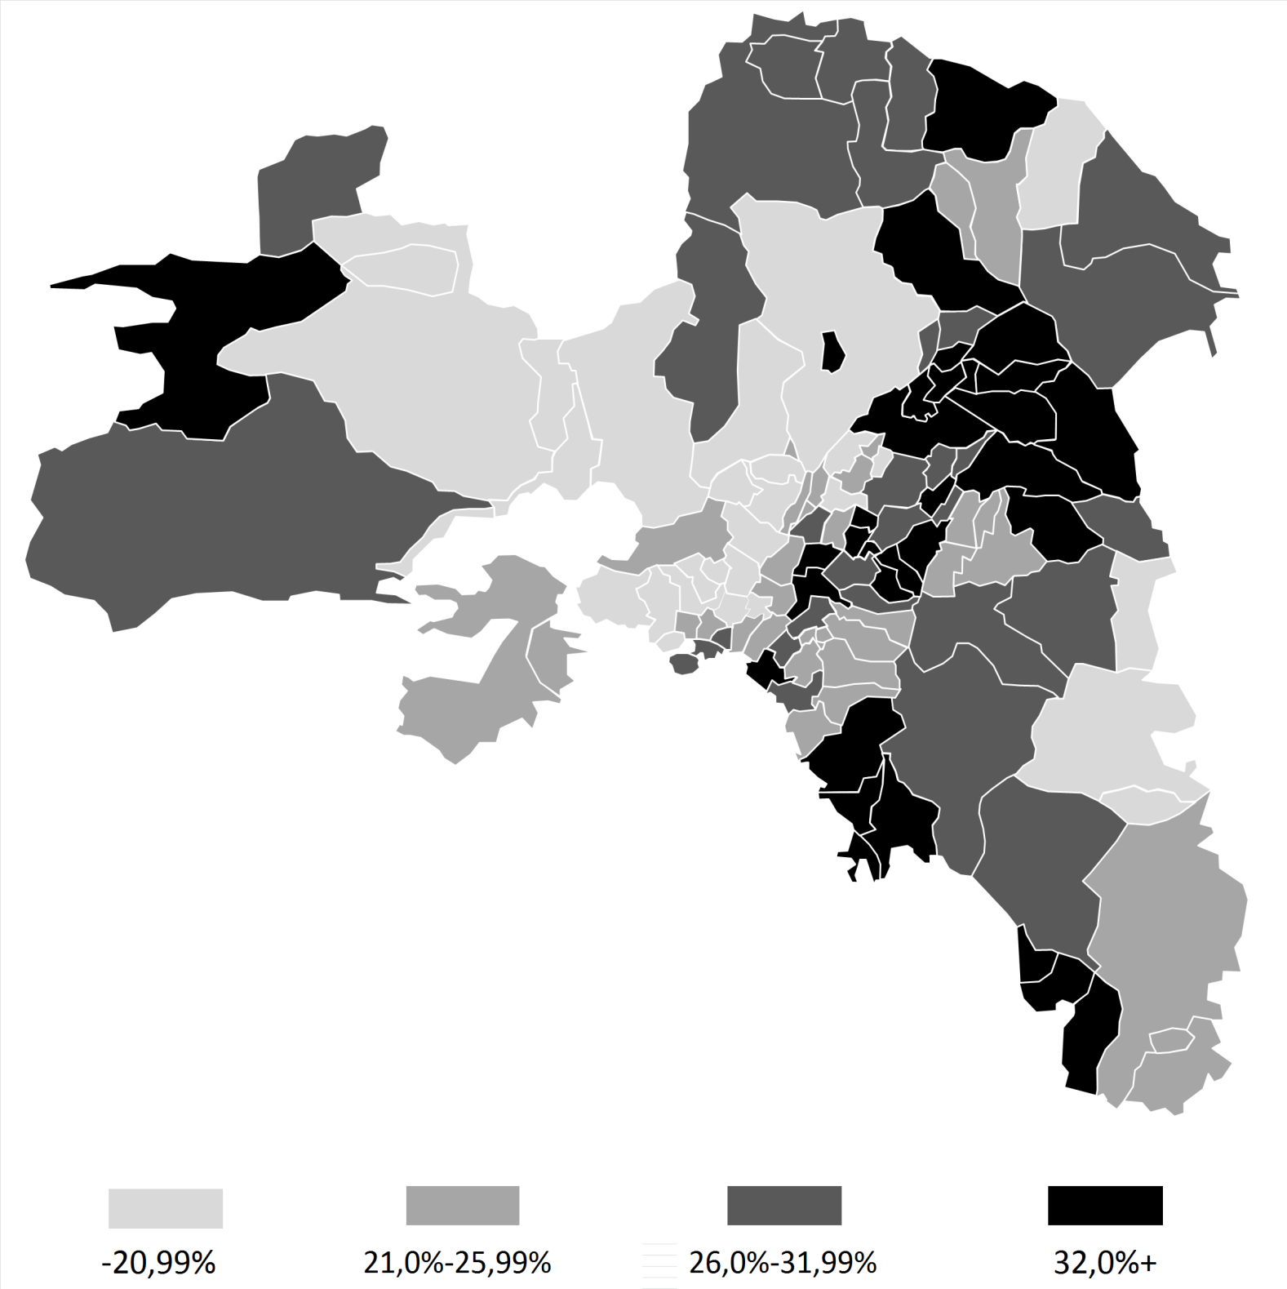
New Democracy Electoral Geography June 2012

Slide 15
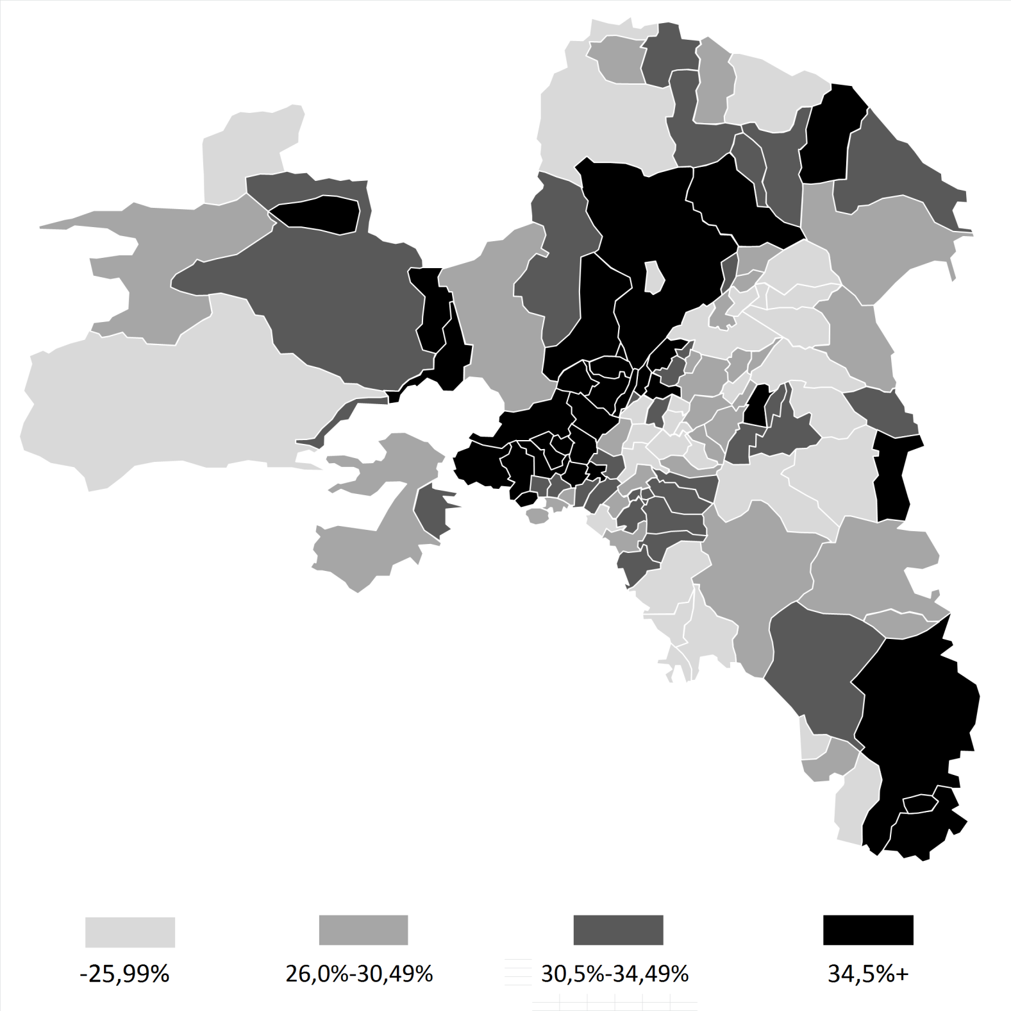
SYRIZA Electoral Geography June 2012

Slide 16
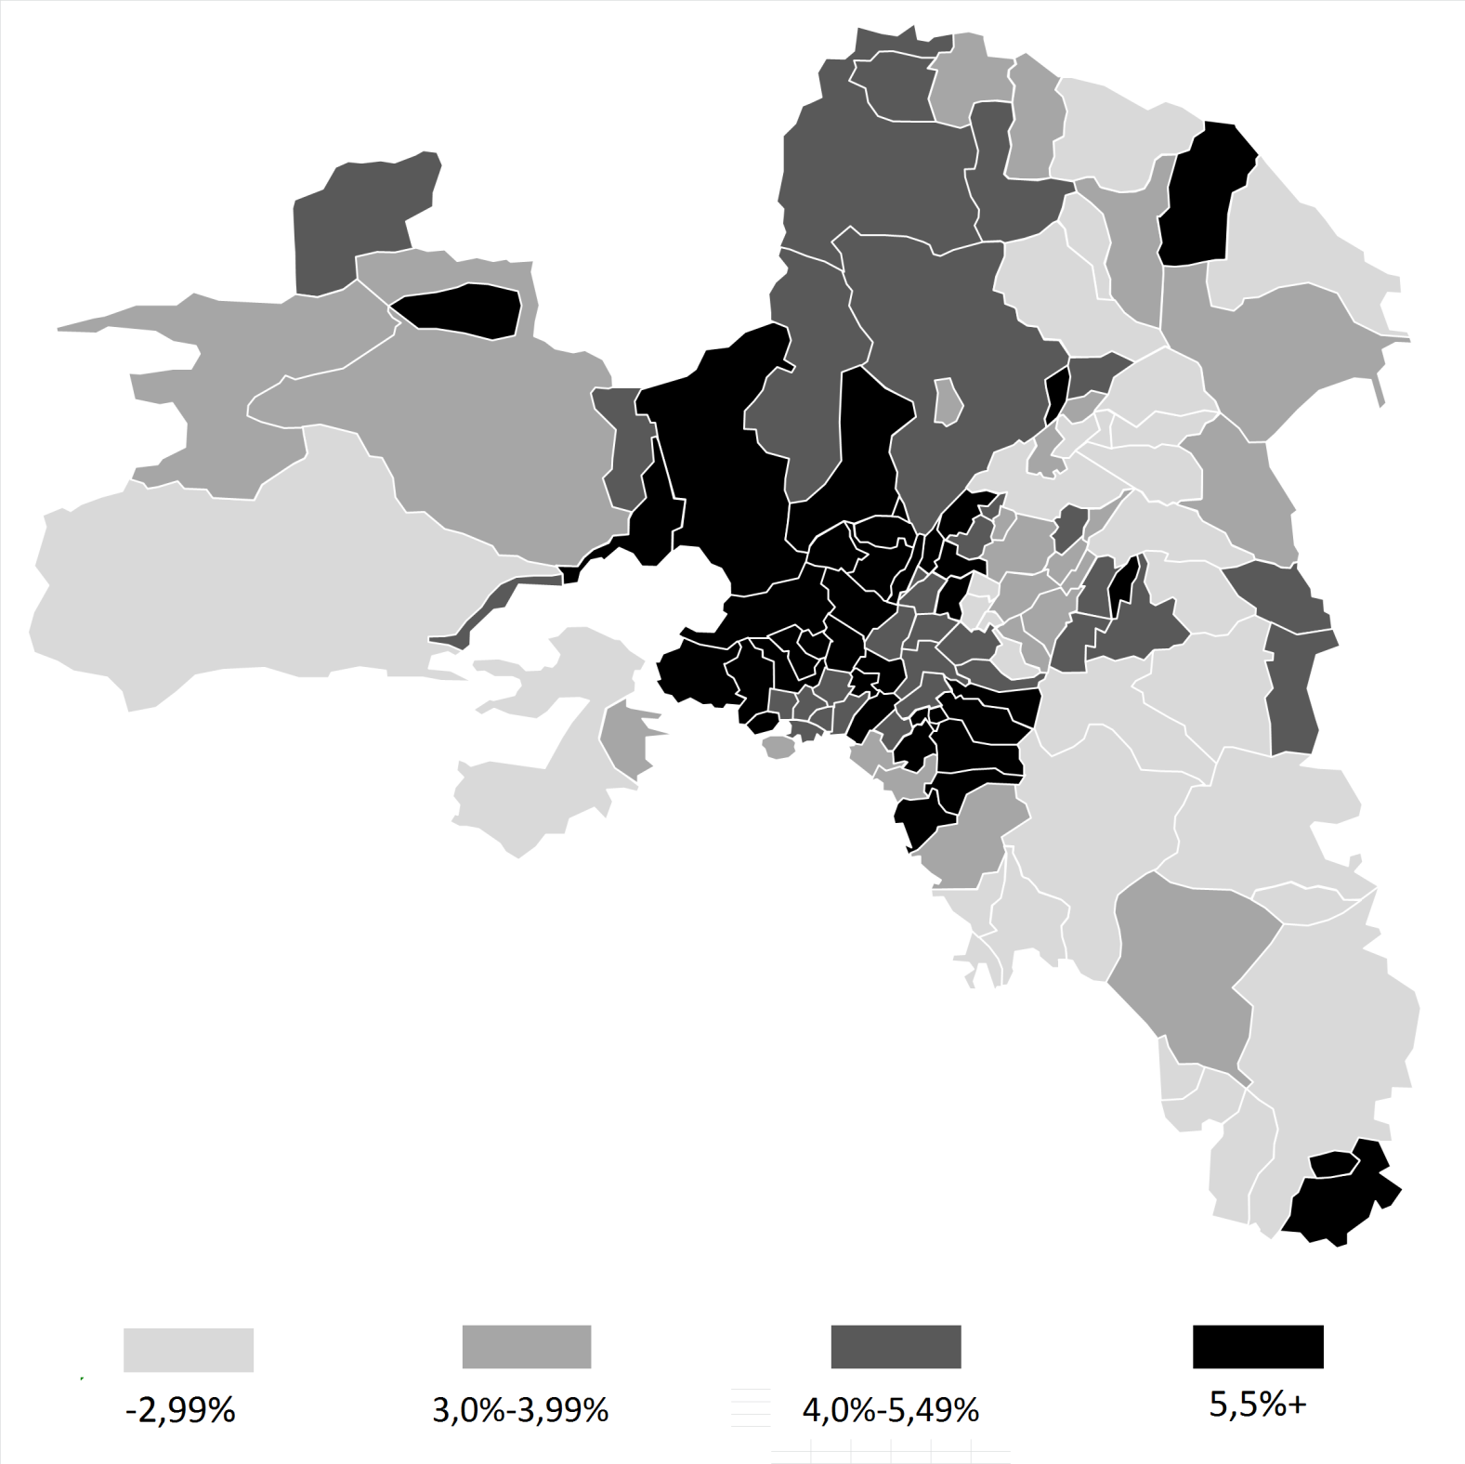
KKE Electoral Geography June 2012

Slide 17
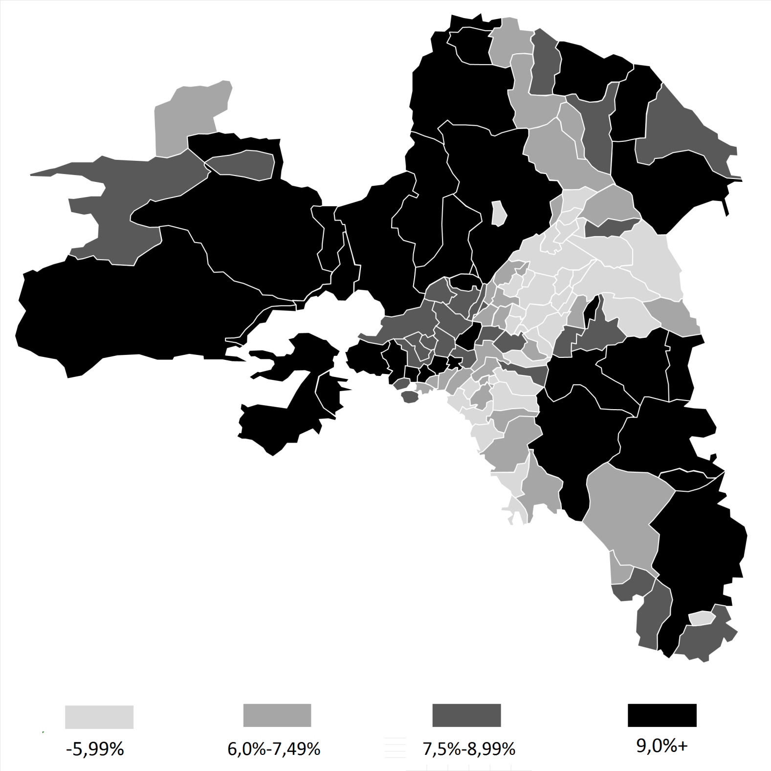
Golden Dawn Electoral Geography June 2012

Slide 18
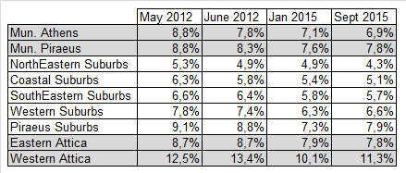
Golden Dawn
Electoral Geography 2012-2015

Slide 19
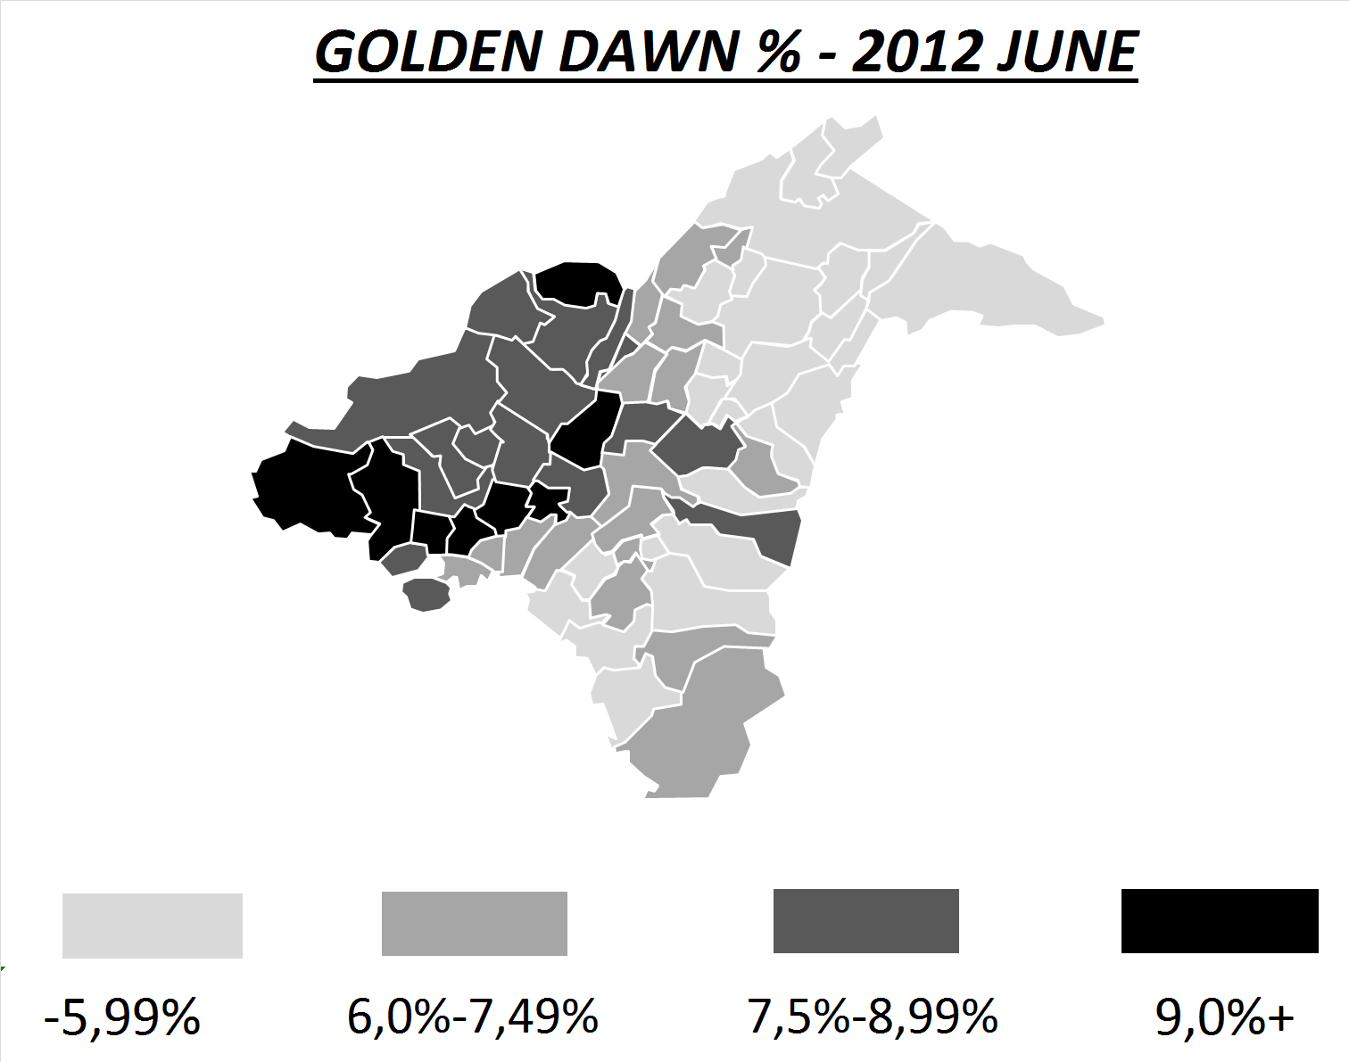
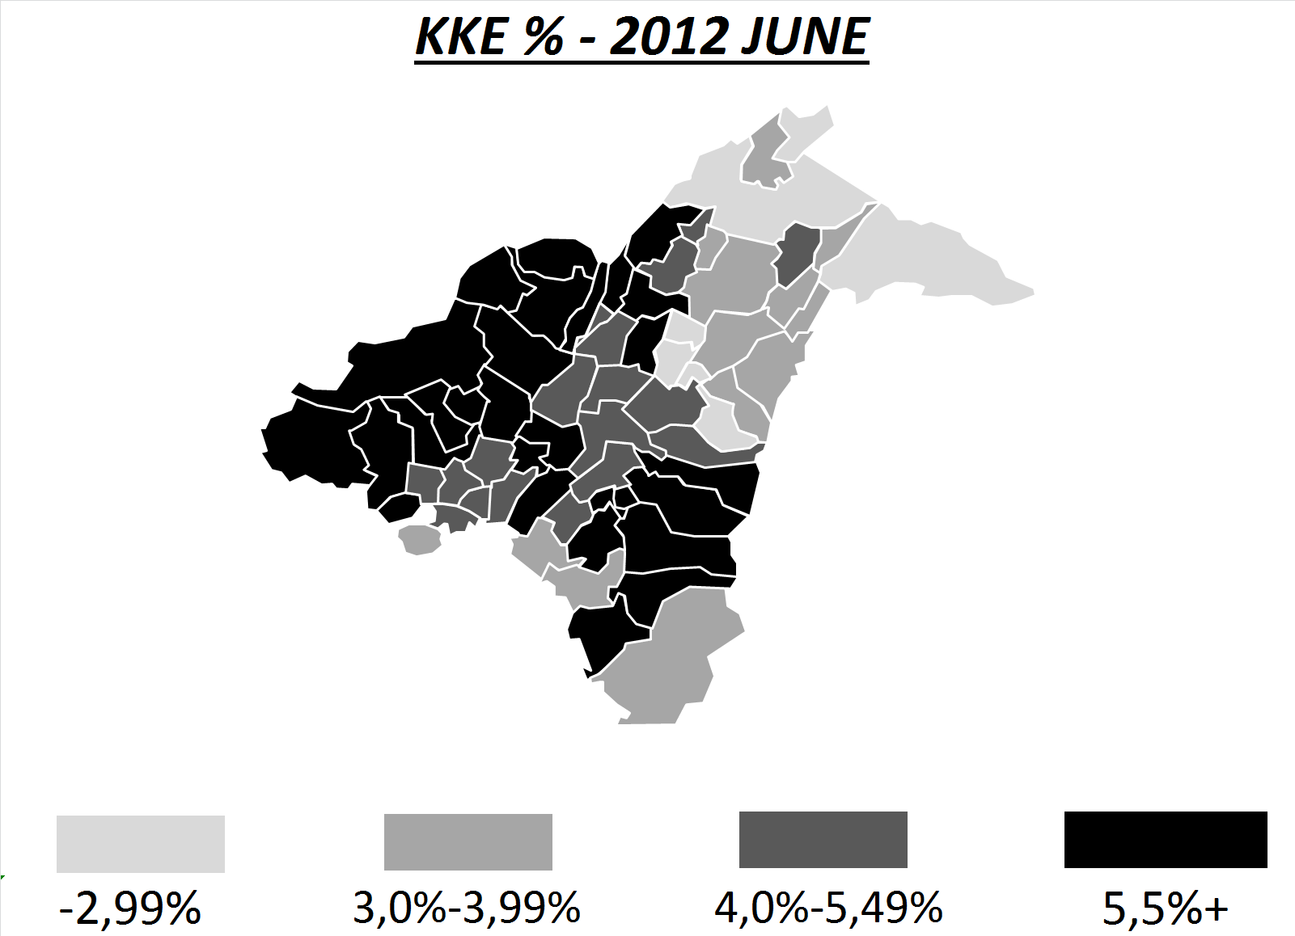
G. Dawn Vs KKE Electoral Geography in Attica Basin

Slide 20
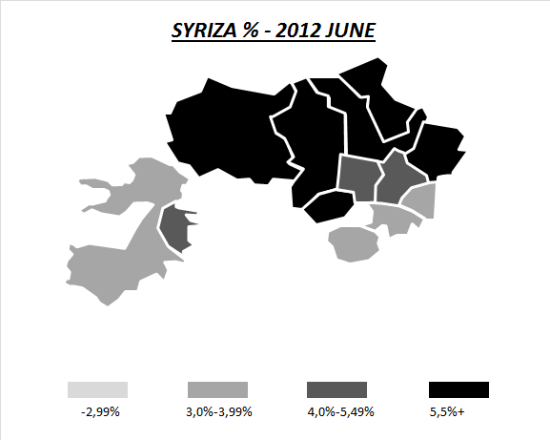
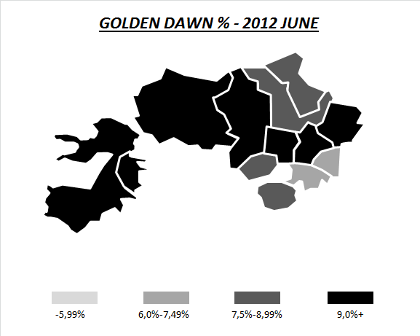
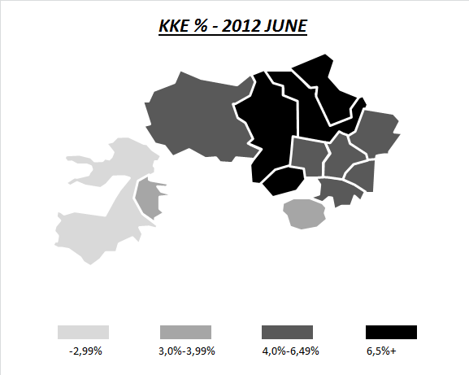
G. Dawn Vs KKE Vs SYRIZA Electoral Geography
in Piraeus Suburbs – 2012 June

Slide 21
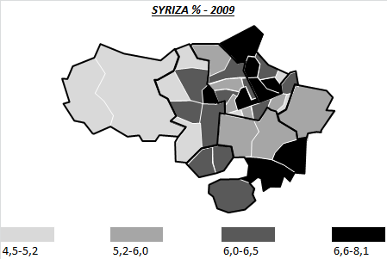
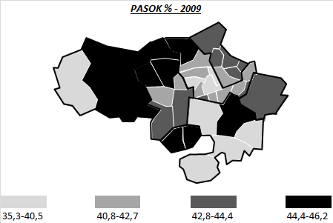
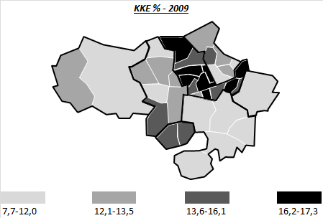
PASOK Vs KKE Vs SYRIZA Electoral Geography
in Piraeus Suburbs – 2009

Slide 22
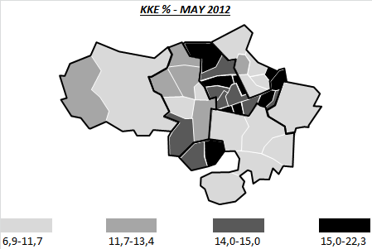
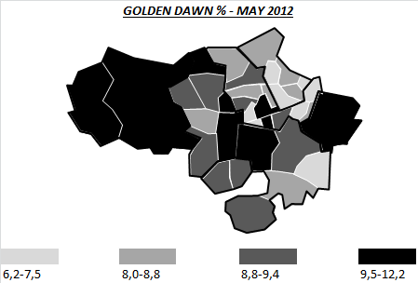
KKE Vs G. Dawn
Electoral Geography
in Piraeus Suburbs – 2012 May

Slide 23
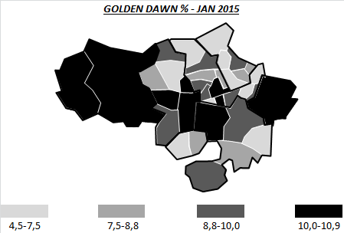
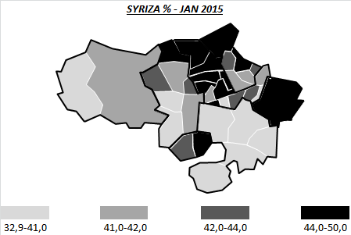
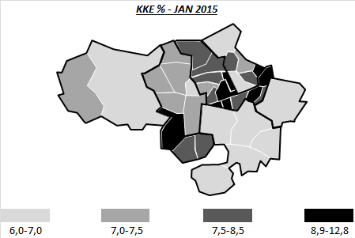
SYRIZA Vs KKE Vs G. Dawn Electoral Geography
in Piraeus Suburbs – Jan 2015

Slide 24
September 2015 – Correlations in Piraeus’ Suburbs
G. Dawn % Vs Population Avg. Income per District: -0,328
G. Dawn % Vs Sample Avg. Income per District : -0,447
G. Dawn % Vs Union Participation per District: -0,250

Slide 25
Concluding Remarks
The traditional working-class of Attica seems to have a distinct socio-economic profile, which is clearer when the analysis goes deeper at the local level.
The electoral geography of working-class suburbs is deeply rooted in the historical context of the working-class formation in the 20th Century. The refugees’ flows from Asia Minor had the most persistent impact.
The extreme-right appeal to the Greek working-class is conditioned upon a) the party competition mainly between the KKE and Golden Dawn, b) the local labour market formation. It seems that stronger occupational identities are negatively correlated with extreme-right electoral preferences.

