Slide 1
Development of a protein-based-assay for the differential diagnosis of Q fever.
Irini Mathioudaki, Iosif Vranakis, Sofia Kokkini, Anna Psaroulaki
9th International Conference of the Hellenic Crystallographic Association (HECRA)
5-7 October 2018

Slide 2
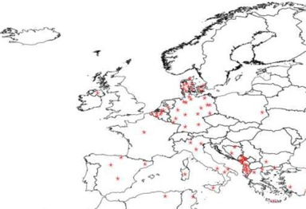
Coxiella burnetii
C. burnetii is the causative agent of the human disease Q fever
World-wide zoonosis
Causes effects on the economy of rural society
Mode of transmission (mainly airborn)
Netherlands 2009-2012 → one of the largest outbreaks of Q fever in humans
4,000 reported
40,000 estimated infected people
The epidemic cost over 300 million €
Notes:
Να τονίσω ότι επιβιώνει στο φαγολυσσοσωμα (στο τελευταίο bullet) → harsh environment

Slide 3
Q fever
Acute stage
High fever
Headache
Fatigue
Muscle aches
Chronic stage
Very serious infection
Development of endocarditis
Can be deadly if not treated correctly

Slide 4
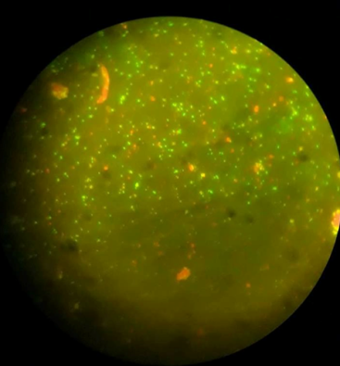
Chronic Q fever diagnosis problem
Current method: immunofluorescence
Disadvantages:
Cost- effective
The requirement of acute and convalescent sera
The objectivity of the interpretation of the results
Potential antibody cross-reactions
The need of experienced personnel
Current method: immunofluorescence
Disadvantages:
Cost- effective
The requirement of acute and convalescent sera
The objectivity of the interpretation of the results
Potential antibody cross-reactions
The need of experienced personnel
Consequently, there is a need to optimize sensitivity and specificity while simplifying the laboratory methods to be followed.

Slide 5
The aims of our study
a) Check the ability of C. burnetii antigenic proteins to differentially diagnose chronic Q fever in patient sera.
b) Ability to develop a fast, reliable, cost-effective and easy-to-use diagnostic test.

Slide 6
Previous studies in our lab showed that…
OmpH is a differentially immunoreactive protein
OmpH is a potential candidate for diagnosis of Q fever endocarditis

Slide 7
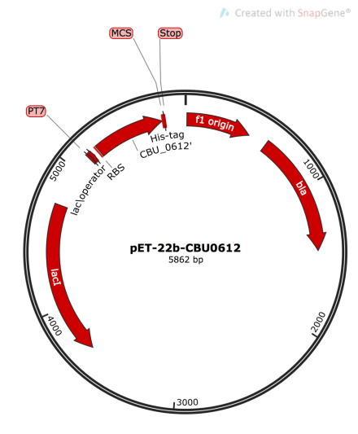
CBU_O612 (OmpH) (Cloning)
Outer membrane protein
18,8 Kda
The plasmid was transformated in C43(DE3) E. coli cells.
Vector pET – 22b

Slide 8
Expression of CBU_0612
Expression conditions tested:
37^{ο} C, 1mM of IPTG
37^{ο} C, 0,5mM of IPTG
Samples:
0h, 2h, 4h, o/n after induction
kDa
0 2 4 o/n 0 2 4 o/n
80
70
50
40
30
20
15

Slide 9
Purification workflow
Membrane Solubilisation
5mg/ml Protein, 1% DDM, 1h
20 mM Hepes, 300 mM NaCl
1 mM EDTA, pH=8, 1mM PMSF
43T, 1h
45 Ti
Affinity Chromatography
Ni-NTA column
Elution with 300 mM Imidazole
Concentrate with Amicon 10 kDa cut off
kDa
kDa
140
80
115
70
80
70
50
50
40
40
30
30
20
20
15
15
SDS-PAGE and Western Blot for the isolated CBU_0612 and Western blot against the His-tag

Slide 10
Immunotesting of acute and chronic Q fever
kDa
kDa
115
140
80
115
70
80
50
70
50
40
40
30
30
20
20
15
15
Immunoblotting using serum from patient with chronic Q fever
Immunoblotting using serum from patient with acute Q fever
No results for serum from patient with acute Q fever
Notes:
Κα

Slide 11
Sample sera used in our study
Unit of Zoonoses, Laboratory of Clinical Microbiology and Microbial Pathogenesis, School of Medicine, University of Crete
National reference centre for Q fever in humans.
Receives patient samples from hospitals from all over Greece
All patient sample sera have been tested with IFA (gold standard method)

Slide 12
Elisa Assay
Patient ID |  | IFA Titre | CBU_0612 ELISA
 | phase I | phase II | 450nm
1898 | 1024 | 2048 | 0,744
1917 | 512 | 2048 | 0,759
2011 | 1024 | 2048 | 0,158 | Acute
2049 | 256 | 512 | 0,198
2076 | 4096 | 512 | 0,158
2078 | 256 | 4096 | 0,157
2211 | 512 | 2048 | 0,945
2238 | 1024 | 2048 | 0,694
2266 | 256 | 1024 | 0,1302
2296 | 512 | 4096 | 0,121
2368 | 2048 | 8192 | 0,117
2402 | 512 | 4096 | 0,152
2762 | 0 | 0 | 0,351
2763 | 0 | 0 | 0,133
2764 | 0 | 0 | 0,344
2766 | 0 | 0 | 0,343
2768 | 0 | 0 | 0,401 | Blood donors
2796 | 0 | 0 | 0,209
2800 | 0 | 0 | 0,158
2804 | 0 | 0 | 0,194
2808 | 0 | 0 | 0,148
2733 | 0 | 0 | 0,334
2052 | 4096 | 8192 | 3,314
2316 | 32768 | 65536 | 3,054 | Chronic
TMB Substrate-Color development
Acute (Average)
0,3611
WASH
Anti-human ab conjugated with enzyme
WASH
Q fever ab (Sample serum)
Healthy (Average)
0,2615
WASH
CBU_0612 (Antigen)
Chronic (Average)
3,184

Slide 13
Future perspectives
Check the ability of 4 others C. burnetii antigenic proteins to differentially diagnose chronic Q fever
Check the ability of C. burnetii antigenic proteins to diagnose Q fever in domestic animals sera
Develop a widely diagnostic kit based on immunochromatography

Slide 14
University of Crete
School of Medicine
Clinical Microbiology and Microbial Pathogenesis Lab
Zoonoses & Geographical Medicine Unit
Ass. Prof. A. Psaroulaki
Financial support
This research/project “Development of a protein-based-assay for the differential diagnosis of Q fever.” is implemented through the Operational Program "Human Resources Development, Education and Lifelong Learning" and is co-financed by the European Union (European Social Fund) and Greek national funds.
Notes:
Γενική γραμματεία Έρευνας και Τεχνολογίας

Slide 15
Acknowledgments
University of Crete
Department of Chemistry
Prof. G. Tsiotis
Max Planck Institute for Biophysics, Frankfurt am Main
Dr. H. Xie
Prof. H. Michel

